Slide 1


SAVITRIBAI PHULE PUNE UNIVERSITY
Department Of Technology
Major Project
SmartCaptioner :
Image Based Caption Retrieval

Slide 2

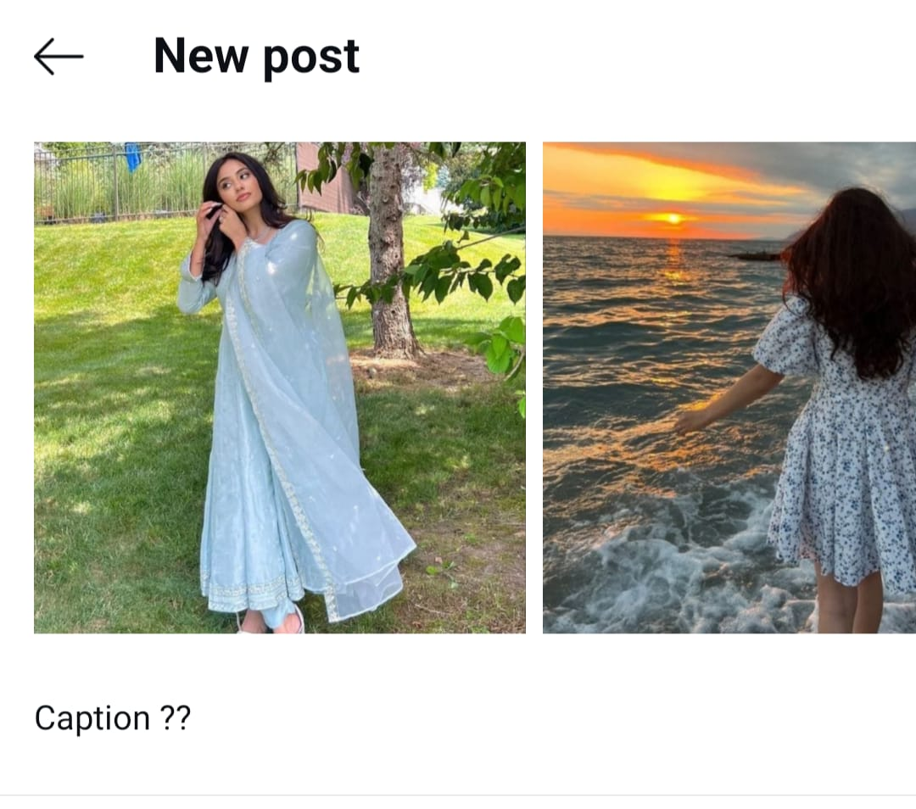

Introduction
Developed an Image-Based Caption Retrieval System using the CLIP model to generate creative captions for Instagram posts. The dataset includes 1600 images across sixteen categories with 8000 captions, aligning text with visual content for enhanced engagement.
Traditional methods like CNNs and LSTMs struggle to create contextually relevant captions. This project leverages CLIP’s ability to align image and text features, addressing these challenges effectively.
To build a system using CLIP that generates accurate, engaging captions reflecting Instagram trends, enhancing personalized content creation.
SmartCaptioner_ searching hours for caption ??

Slide 3

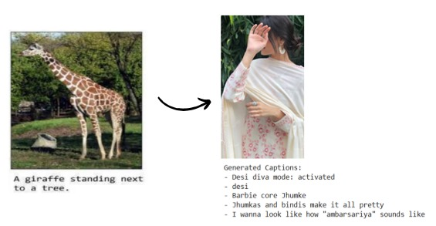
Problem Statement
Generating accurate and creative captions for images on platforms like Instagram remains a challenge. Traditional methods (CNNs for image features and LSTMs for captions) struggle with aligning captions with image content and trends. This project aims to overcome these limitations by using the CLIP model, which processes both image and text together for better contextual alignment, creating more relevant and engaging captions.
SmartCaptioner_ CNN- LSTM ❌ CLIP ✅

Slide 4

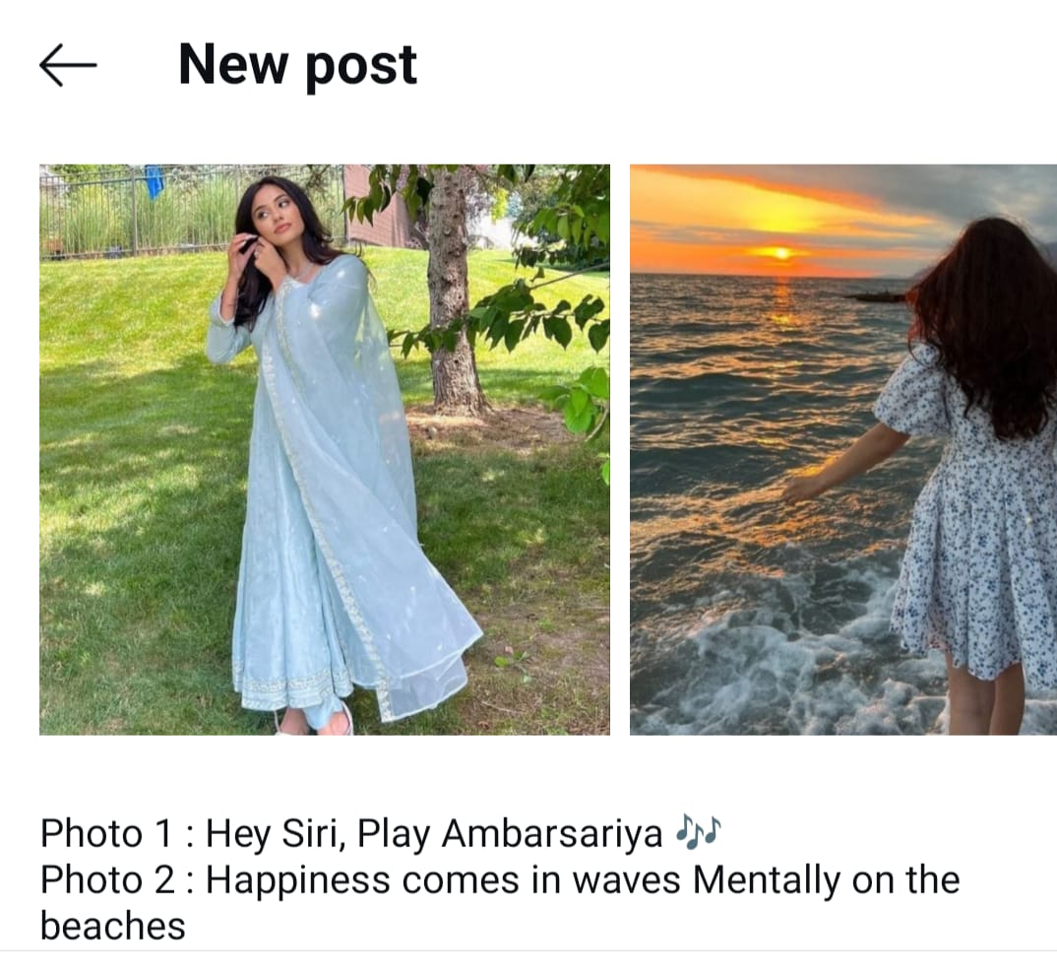
Objective
To create an Image-Based Caption Retrieval System using the CLIP model to extract image features and generate captions based on text-image similarity. The system aims to deliver contextually accurate captions that enhance social media engagement.
Utilizes a custom dataset with 1600 images across sixteen categories and 8000 captions (5 captions per image). Employs CLIP for feature extraction and caption alignment.
Focuses on generating captions tailored to Instagram's content trends and audience.
SmartCaptioner_ Making your pics Insta-poetic with CLIP magic!

Slide 5

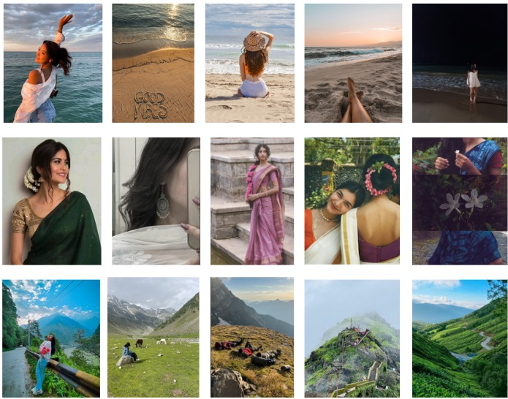
Dataset
Dataset Size: 1600 images categorized into sixteen distinct classes.
Categories: Birthday, Baddie, Beaches, Cafe, Cats, Christmas, Couples, desi, Diwali, Dogs, Friends, Mirror, Monsoon, Mountain, Sky, Sunkissed.
Captions: 5 captions per image, totaling 8000 captions.
Source: Collected from Pinterest, google, chatbots ensuring diverse and relevant content.
Purpose: Designed to reflect the unique tone and themes of Instagram content for enhanced context and engagement in caption retrieval.
SmartCaptioner_ From Pinterest to Insta-fame—our dataset has its priorities straight!

Slide 6
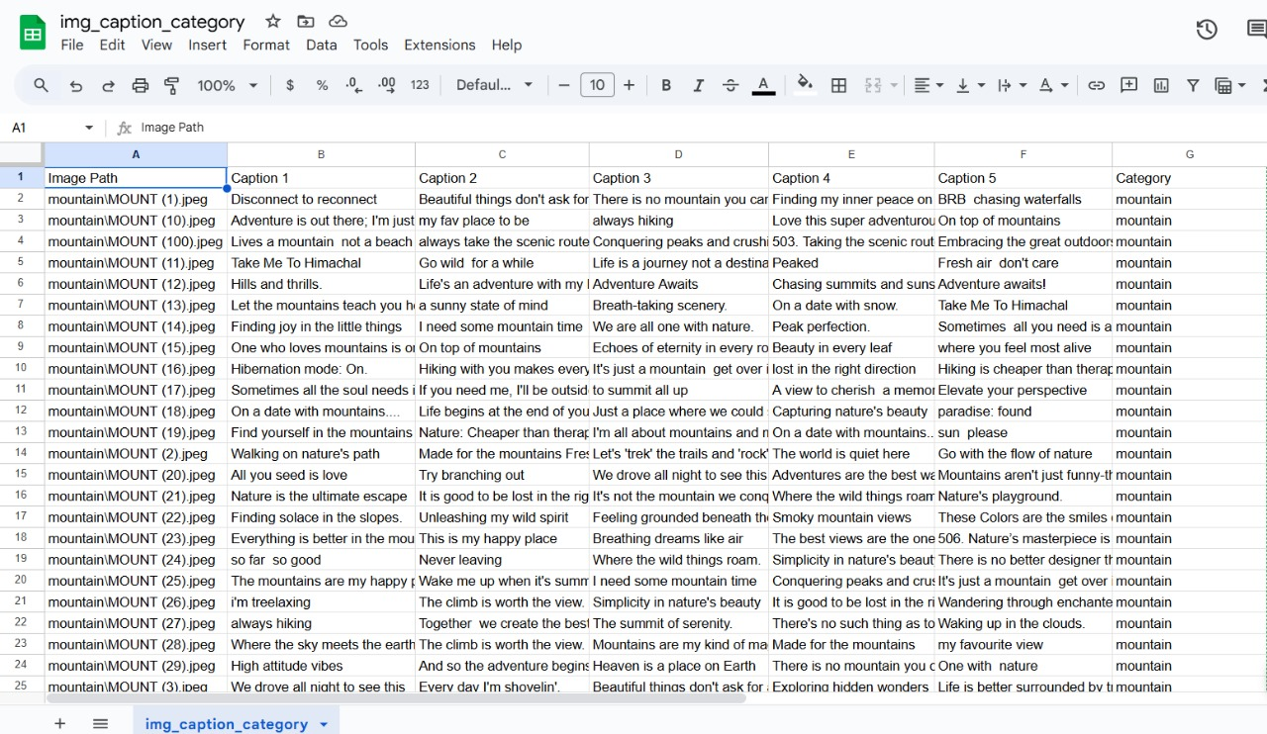

Slide 7

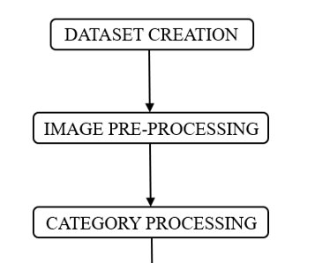
Research Methodology
Steps Involved:
Dataset Creation:
1600 images across three categories (Birthday, Baddie, Beaches, Cafe, Cats, Christmas, Couples, desi, Diwali, Dogs, Friends, Mirror, Monsoon, Mountain, Sky, Sunkissed).
5 captions per image, totaling 8000 captions, sourced from Pinterest.
Image Preprocessing:
Images resized to 224x224 pixels and normalized.
CLIP model extracts semantic features linking text and image.
Category Preprocessing:
Images categorized into predefined classes.
Caption selection based on the predicted category ensures relevance.
1/2
SmartCaptioner_ Preprocessing: the glow-up your images didn’t know they needed.

Slide 8
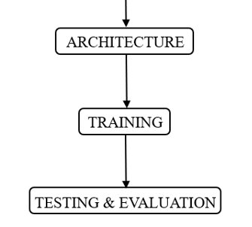
Research Methodology
Architecture:
Feature Extraction: CLIP model generates high-dimensional image vectors.
Caption Generation: A custom function selects captions matching the predicted category.
Testing and Evaluation:
CLIP predicts categories for unseen images.
Captions selected from the dataset and qualitatively evaluated for relevance and creativity.
2/2
1/2
SmartCaptioner_ Testing: Because even captions need a creativity check

Slide 9
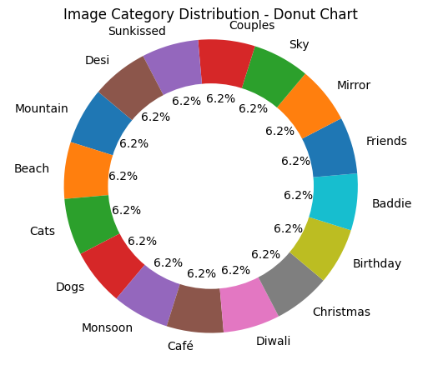
Data Analysis
Key Observations:
Caption Diversity:
Captions blend nouns, verbs, and adjectives, enhancing descriptiveness.
75% contain keywords aligning with their categories, ensuring relevance.
Varied sentence structures add linguistic richness.
Image Features:
Images resized to 224x224 pixels for consistency.
CLIP model effectively distinguishes visual embeddings across categories.
SmartCaptioner_ 75% keyword match: because captions should vibe, not clash.

Slide 10

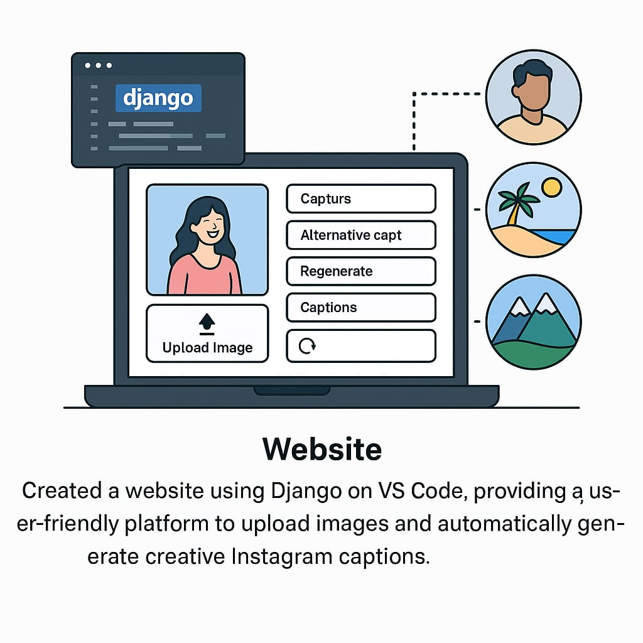
User – Interface
1/4
1/2
WEBSITE CREATION
Created a website using Django on VS Code, providing a user-friendly platform to upload images and automatically generate creative Instagram captions. It supports sixteen different image categories and provides five relevant captions per image, with the option to regenerate captions based on user preference. Currently, the website is free to use and does not require signup, though this may be enhanced in the future. It integrates with a backend ML model to deliver fast and accurate caption suggestions.
SmartCaptioner_ Snap, upload, and let SmartCaptioner do the talking!

Slide 11

User – Interface
1/2
SmartCaptioner_ The website!

Slide 12

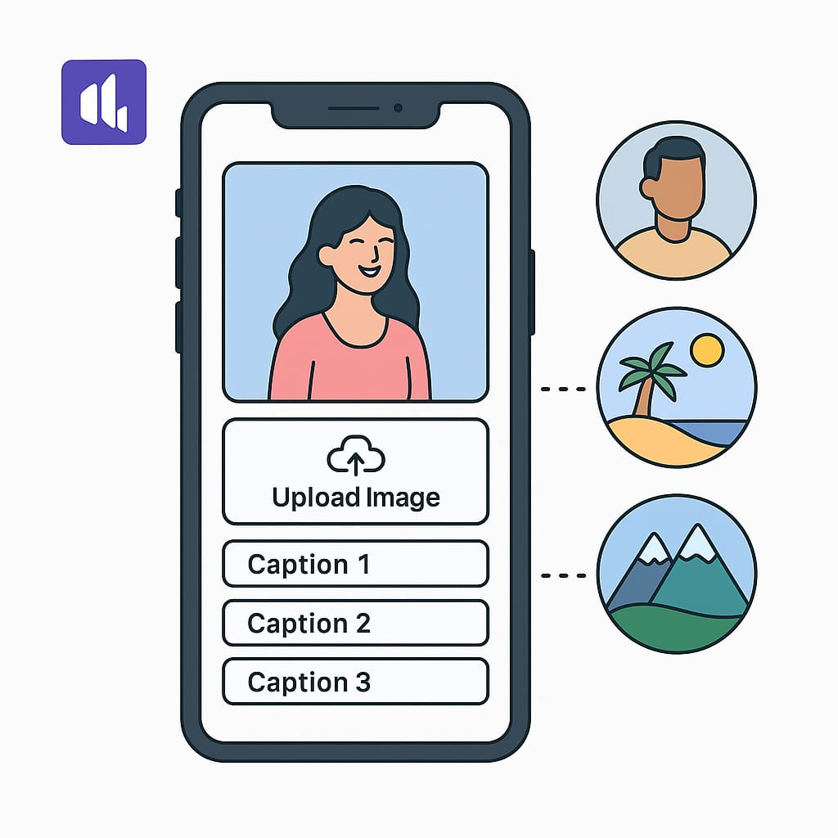
User – Interface
MOBILE APPLICATION
A mobile application for SmartCaptioner was developed using Kodular, providing users with an easy and portable way to access the caption generator on Android devices. The app features a clean and simple interface that allows users to upload images directly from their phones. It is seamlessly integrated with the Django backend, ensuring fast and accurate caption suggestions. Just like the website, the app supports sixteen different image categories and provides five creative captions for each image, along with a regenerate option for alternative suggestions. The app does not require any sign-up or login, ensuring a smooth and hassle-free user experience, making SmartCaptioner easily accessible on the go.
3/4
1/2
SmartCaptioner_ Snap, upload, and let SmartCaptioner do the talking!

Slide 13
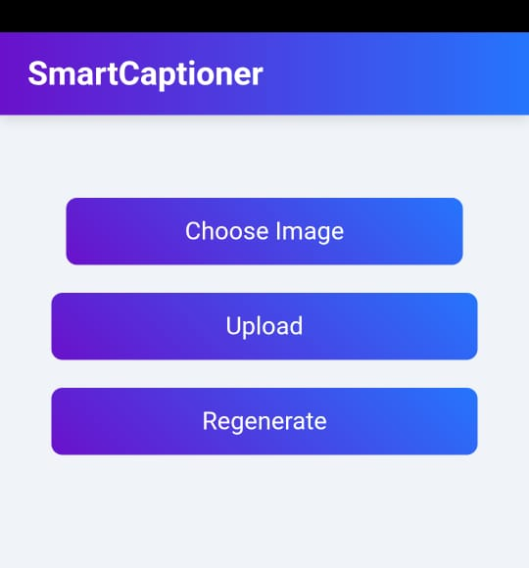
User – Interface
1/2
SmartCaptioner_ The App!!

Slide 14
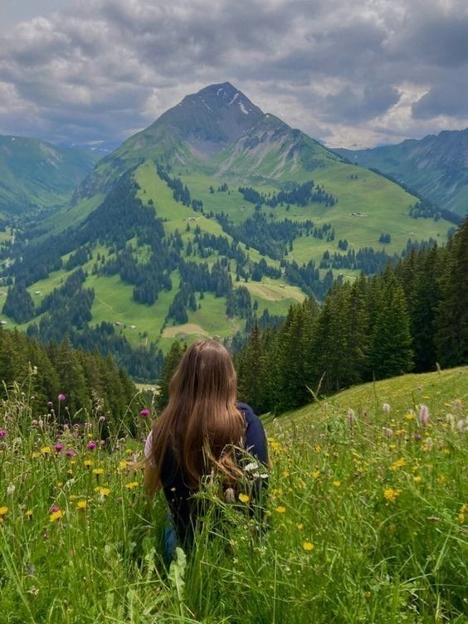
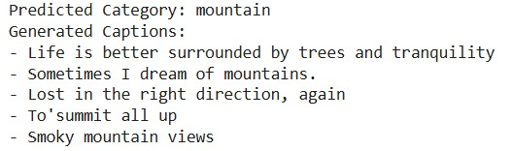
Results

Slide 15
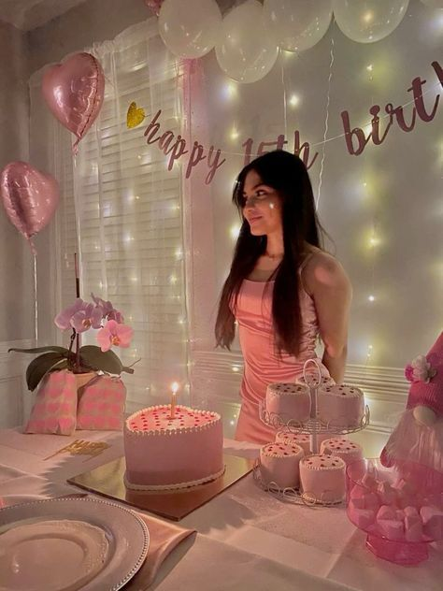
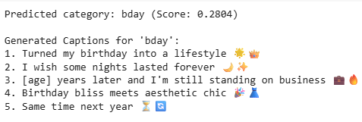
Results

Slide 16
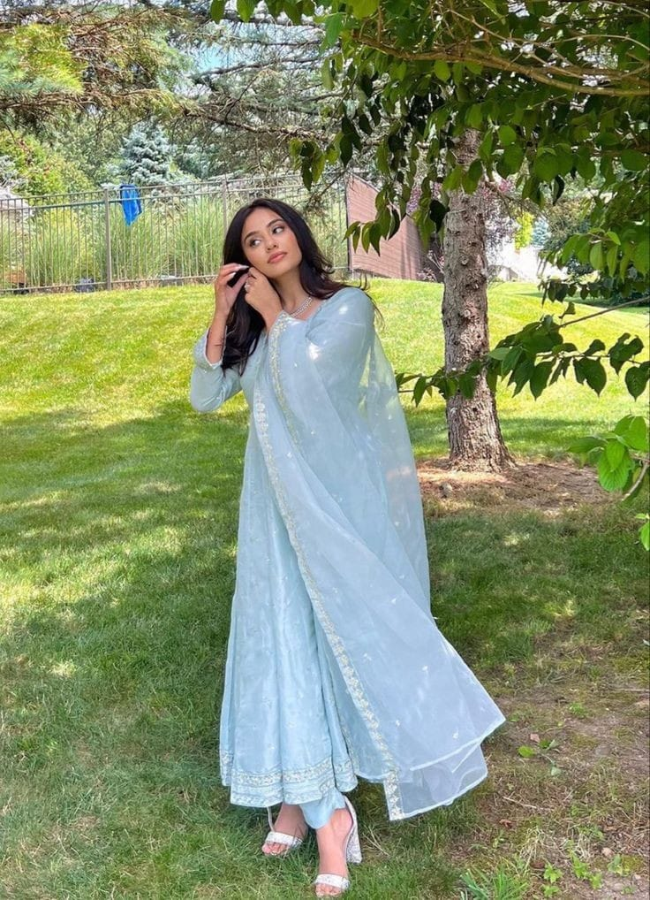
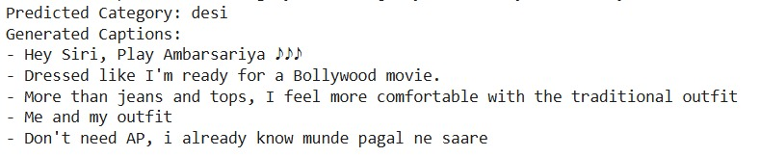
Results

Slide 17
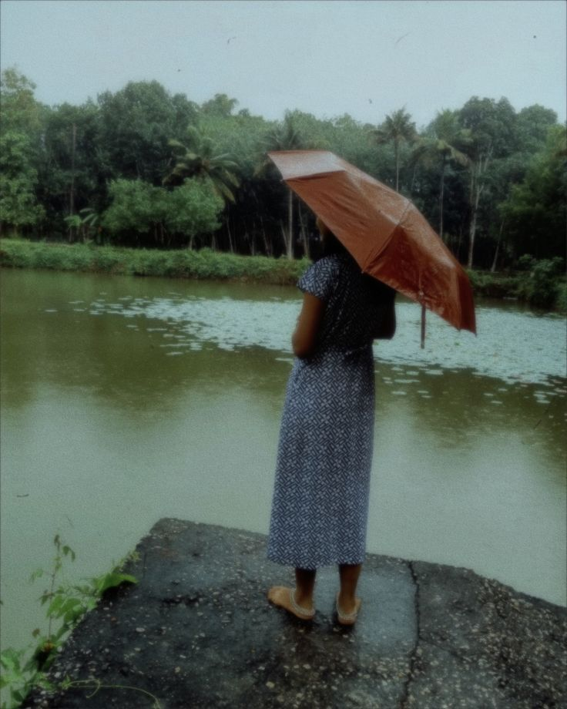
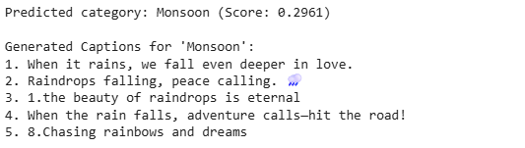
Results

Slide 18
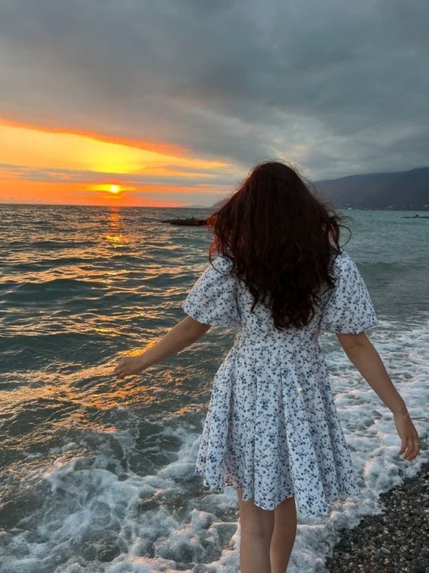
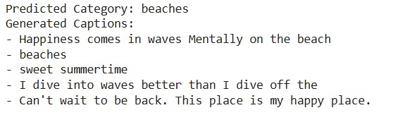
Results

Slide 19
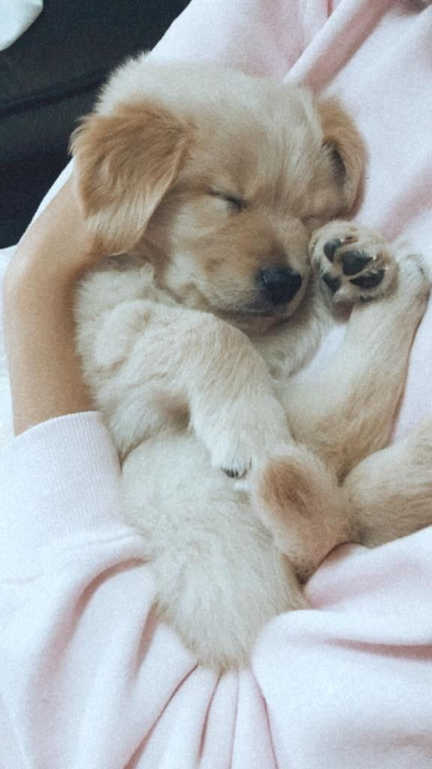
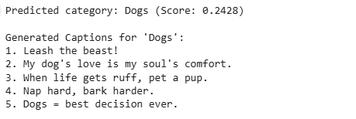
Results

Slide 20

Literature Review
2.1 Introduction
Image captioning has evolved from traditional CNN-LSTM models to more advanced systems like CLIP (Contrastive Language-Image Pretraining).
CLIP bridges image and text processing, enabling better contextual and creative caption generation.
This chapter explores these developments and their influence on the proposed Instagram caption generator system.
2.2 Image Captioning Systems
Image captioning generates textual descriptions for images, with the challenge of aligning visual content and language.
Recent advances like CLIP have improved accuracy and creativity in generating captions that reflect both image and textual context.
1/4
SmartCaptioner_ when captions went from basic to brilliant!

Slide 21
Literature Review
2.2.1 CLIP for Image and Text Alignment
CLIP processes images and text in parallel, mapping them into a shared embedding space.
This allows for better alignment between the image's visual content and the generated caption.
CLIP’s use of vision and language encoders enhances both image-text understanding and context relevance.
2.2.2 Previous Techniques: CNNs and LSTMs
CNNs (e.g., InceptionV3) were used for feature extraction, while LSTMs generated captions word by word.
Despite their strengths, CNN-LSTM models struggled with contextual alignment between images and captions.
CLIP's simultaneous image and text processing overcomes this limitation.
2/4
SmartCaptioner_ Goodbye, CNN-LSTM struggles; hello, seamless context with CLIP!

Slide 22
Literature Review
2.3 Tokenization and Padding
Traditional CNN-LSTM systems use tokenization and padding to process captions, which is crucial for sequential word generation.
CLIP eliminates the need for tokenization by using parallel processing of images and text, which simplifies the workflow.
2.4 Model Architecture
Image-Text Encoder (CLIP): Embeds both image and caption in a shared feature space.
Caption Generation: Predicts the most relevant caption by analyzing image-text relationships, without sequential word generation.
3/4
SmartCaptioner_ Tokenization? Padding? CLIP says, 'Not my problem.' #ParallelProcessing

Slide 23
Literature Review
4/4
2.5 Training and Optimization
Traditional models: Used categorical cross-entropy and Adam optimizer.
CLIP-based system: Focuses on maximizing similarity between image and text embeddings using contrastive loss functions, ensuring contextually relevant and trend-aligned captions.
SmartCaptioner_ CLIP: Forget cross-entropy, it's all about maximizing similarity!

Slide 24

Conclusion
The project successfully developed an Image-Based Caption Retrieval System using the CLIP model for feature extraction. Since CLIP was pre-trained on 400 million image text pairs from the internet , it could retrieve relevant captions for the images without any additional training. But providing a custom dataset improves its accuracy to produce relevant captions specific to the need . It alone can handle the task of extracting features and then providing relevant captions for the image and vice versa . It can also handle small datasets very efficiently, where the CNN-LSTM models might overfit . Also due to its extensive pre-training it can handle unseen images easily .
SmartCaptioner_ Smart Captioner understood the assignment!!

